Slide 1
INFO 4330 Data Warehouse/Mining Final Project
James Tariga Ali Manghat

Slide 2
Table of contents
01.
02.
03.
Background
Linear Regression
Clustering
04.
05.
06.
Comparing Results
Logistic Regression/K-Nearest Neighbors
Summary

Slide 3
Background
Explored COVID-19 data using various machine learning models
The chosen dataset provided a detailed overview of the recent pandemic and COVID-19 statistics for various regions worldwide
Applied supervised learning models including Linear Regression, K-Nearest Neighbors, and Logistical Regression
Investigated the topic of unsupervised learning through Clustering.
Applied many of the machine learning techniques learned in class to this real-world dataset

Slide 4
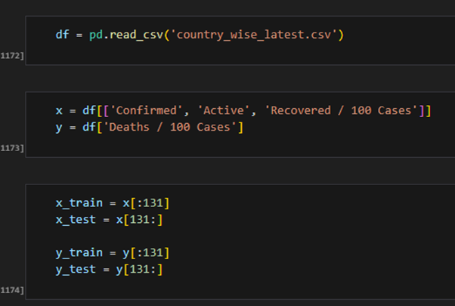
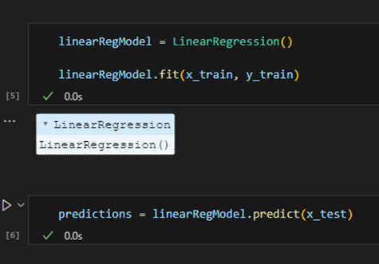
Linear Regression
Used ‘Confirmed’, ‘Active’, ‘Recovered / 100 Cases’ as the independent variables, and ‘Death / 100 cases’ as the dependent variable.
Split the data set for the first 131 rows for training and the remaining for testing. There are a total of 188 rows.
Created a linear regression model.
Trained the model using the training data.We make predictions on the model using the testing data.

Slide 5
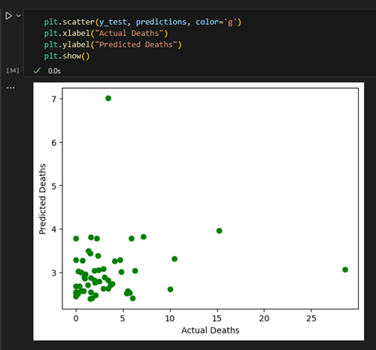
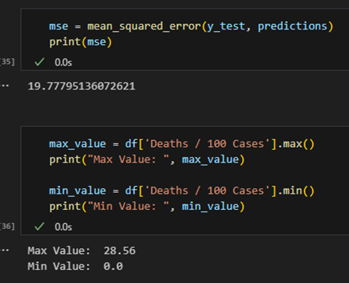
Linear Regression
The scatter plot shows the actual and predicted values of the deaths / 100 cases.
The MSE is 19.78 which is relatively low. This means that the model is pretty accurate. The predicted values are like the actual values. We can see the max value for the dependent variable ‘Deaths / 100 cases’ is 28.56 and the lowest is 0. This further proves that the MSE is relatively accurate.

Slide 6
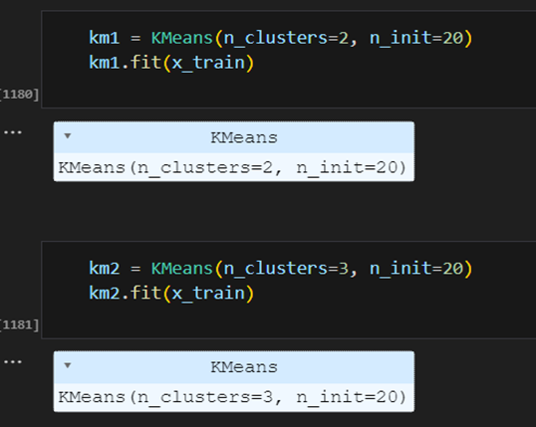
Clustering
There two clustering models. The first with 2 clusters, and the second with 3 clusters.

Slide 7
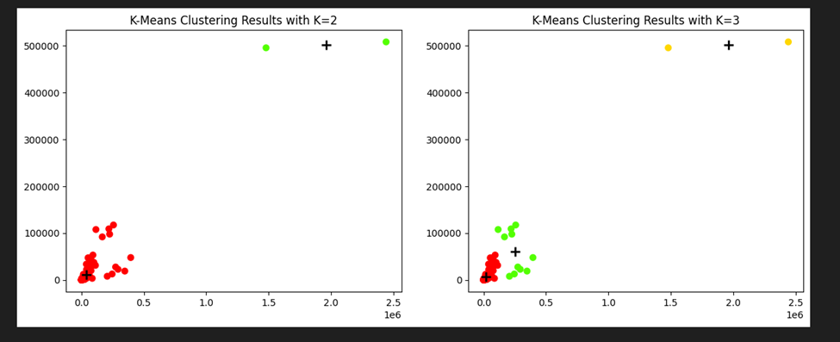
Clustering
Plotting the clustered data. Here we can see the two models plotted.
The graph on the left represents the first model which is grouping the data into two clusters and on the right the model is grouping the data in three clusters.
We can see covid-19 cases/deaths grouped by different regions.
First world countries have a much lower number of deaths, the number increases as the countries become less developed. The centroids have also been plotted to show the ‘mean’ for each of the clusters.

Slide 8
Comparing Results
Both Linear Regression and Clustering have specific use cases.
The choice of model depends on the prediction goal.
In our scenario, Linear Regression is used to predict the number of deaths based on features like confirmed cases, recovered cases, and active cases.
Clustering helps us visualize regions with the highest death rates but doesn’t help us predict deaths based on the features.
Linear Regression is more appropriate for this scenario for prediction purposes.
Clustering is useful for visualizing similarities in the data.

Slide 9
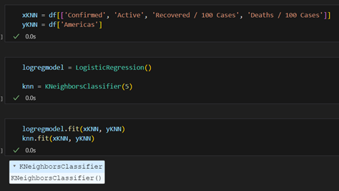
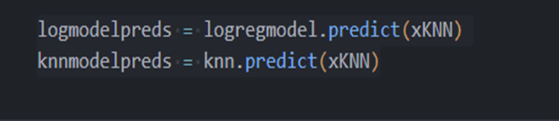
Logistic Regression/K-Nearest Neighbors
Feature is xKNN and a dependent called yKNN to train the model. Then the models are trained using the fit method on the provided training data.
We then make predictions on the same training data using the trained models.

Slide 10
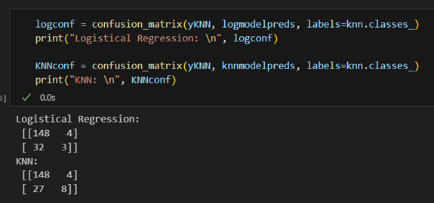
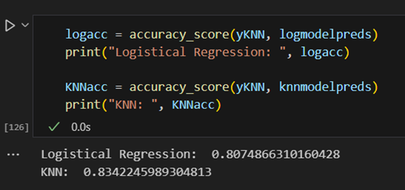
Logistic Regression/K-Nearest Neighbors
Confusion matrices are computed for both models using the true labels (yKNN) and predicted labels (logmodelpreds, knnmodelpreds).
The accuracy scores are calculated for both models using the true labels and predicted labels.

Slide 11
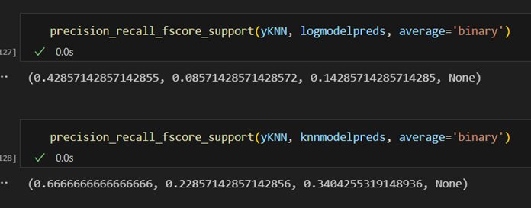
Logistic Regression/K-Nearest Neighbors
Precision, recall, and F1-score are computed using the precision_recall_fscore_support function for both models, considering a binary classification scenario.
This essentially trains two classifiers, makes predictions, evaluates their performance using confusion matrices, accuracy scores, and precision-recall-f1 metrics. It provides a comprehensive overview of how well each model is performing on the given dataset.

Slide 12
Comparing Results
Logistic Regression model performs well on majority class but struggles with minority class.
KNN model shows slight improvement over Logistic Regression in predicting minority class.
KNN has better overall prediction accuracy.
Both models struggle with minority class due to imbalanced dataset.
Improvements can be made by resampling dataset, trying different algorithms, feature selection methods, adjusting decision threshold, and addressing class imbalance.

Slide 13
Reference
Citation of data set:
Devakumar, K.P. (n.d.). Corona Virus Report. Kaggle. Retrieved from
https://www.kaggle.com/datasets/imdevskp/corona-virus-report

